Slide 1
Direct Numerical Simulation of Compressible Flows with Shock Wave and Boundary Layer Interaction
Presented by
DEVYANSH AGARHARI
231010021

Slide 2
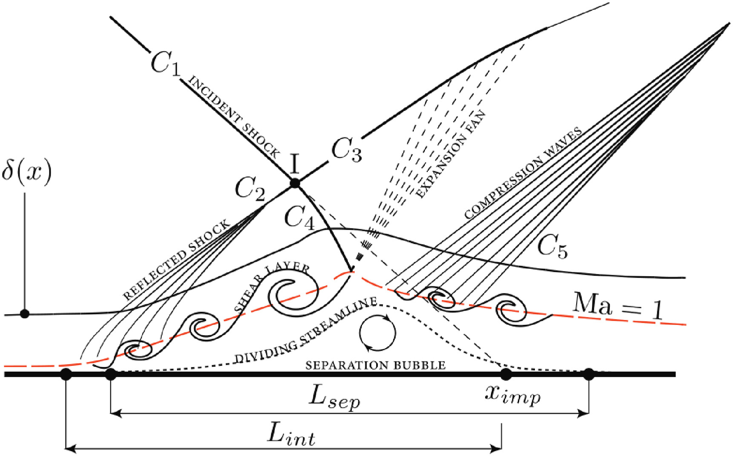
Introduction
Schematic diagram of canonical Shock impingement on the boundary layer.

Slide 3
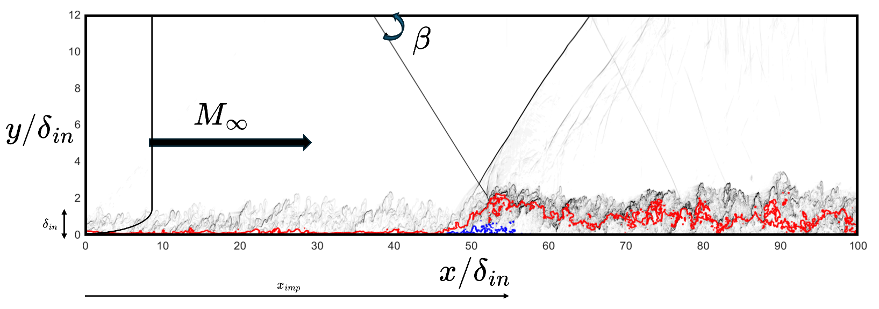

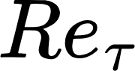
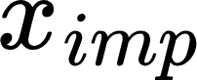
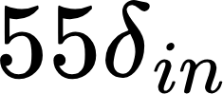
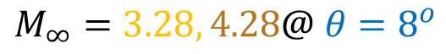
Problem Description
Mach at inlet =
= 200/250 @ inlet
Impingement location ( ) =
Boundary conditions
Inlet | turbulent BL (recycling-rescaling)
Outlet | Zero gradient for Pressure
Top | shock Hugoniot jump/non-reflective
Bottom | No-slip/Viscous-Iso thermal wall
Sides | Periodic
DNS1,DNS2,DNS3,DNS4
$$θ=7^{o},8^{o},{8.8}^{o},{9.5}^{o}@ M_{∞}=2.28$$
DNS5,DNS6
$$M_{∞}=3.28, 4.28@ θ=8^{o}$$

Slide 4
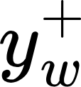
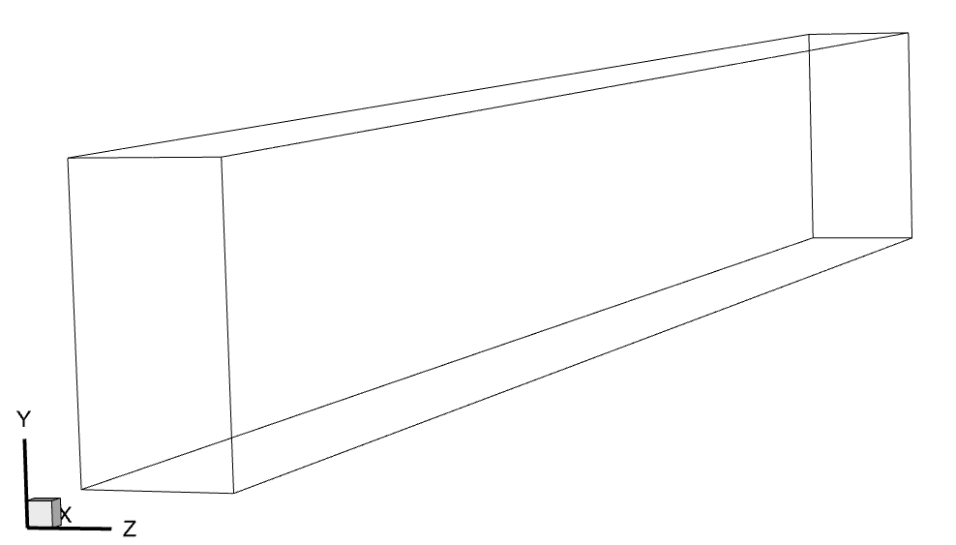

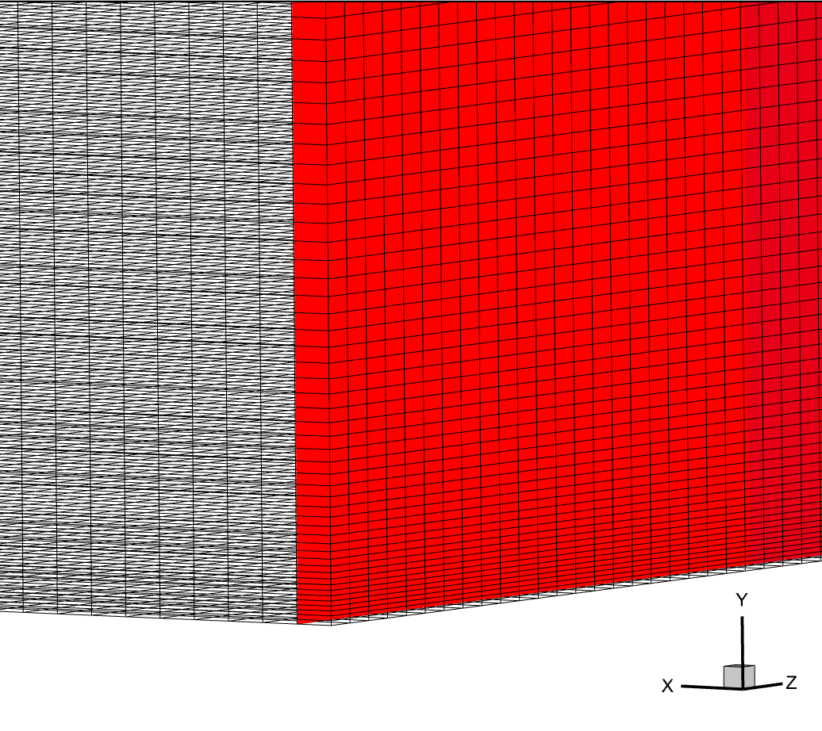


Computational domain
= 0.7
Grid points
Grid resolution

Slide 5
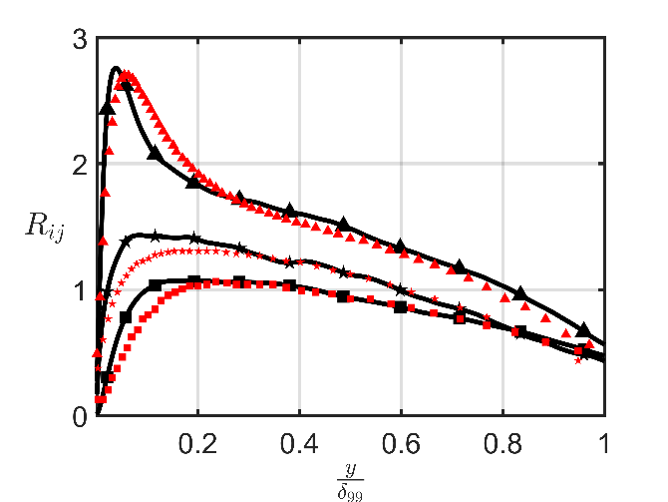
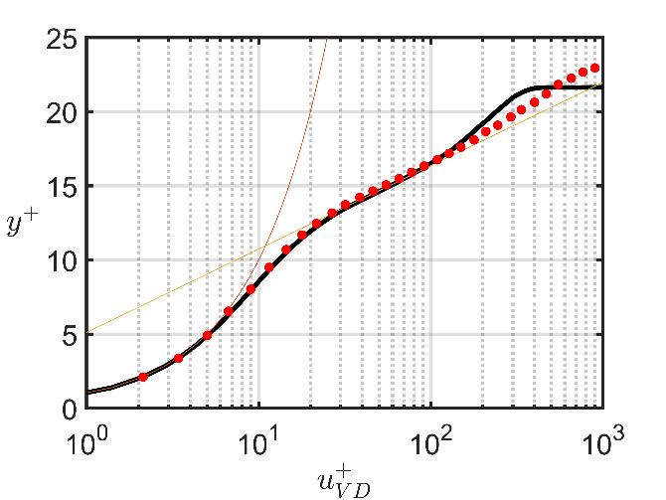
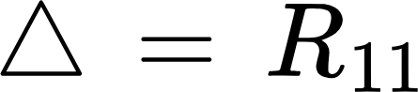

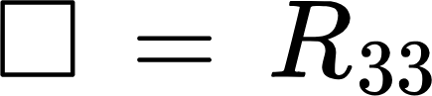
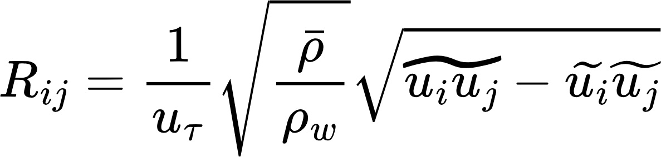
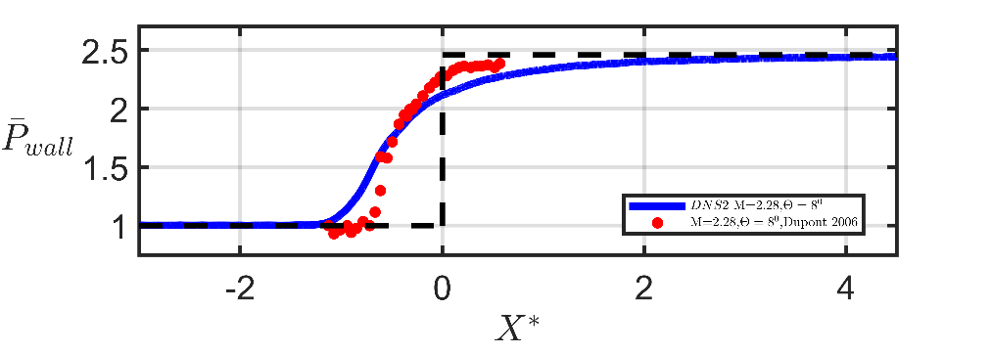
Numerical Methods used for DNS
Pirrozoli et al. at ref loc = 45delta
6th order central difference scheme to discretize viscous terms.
Used a WENO(5th) and KEEP(6th) blended scheme for convective terms.
Temporal discretization is achieved through the RK3 method.
Validated against Dupont et al.[1] for DNS2

Slide 6
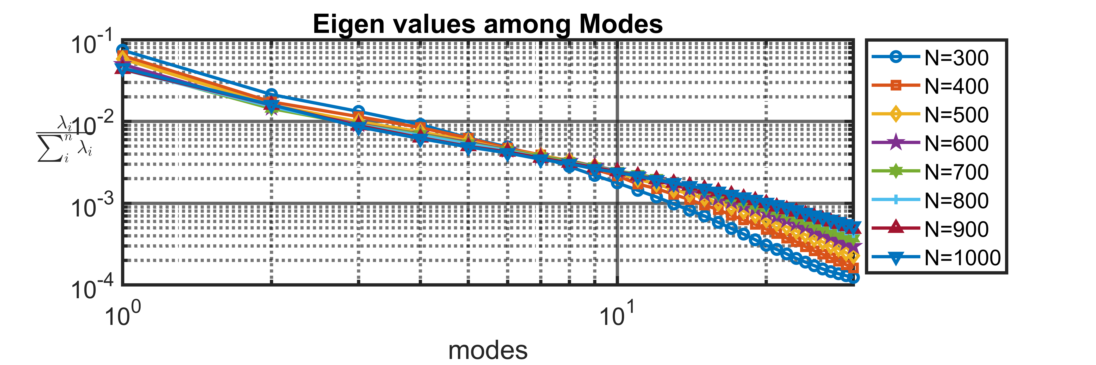
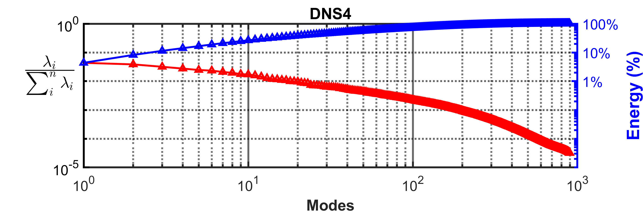
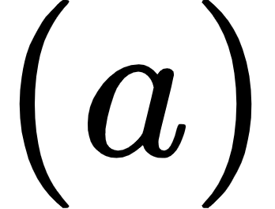
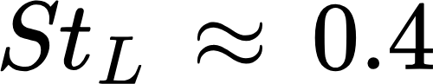
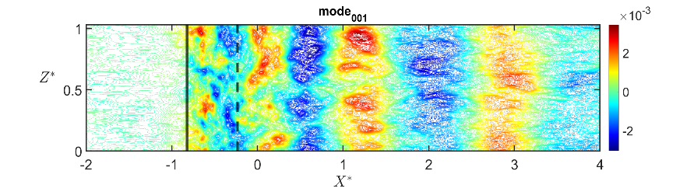
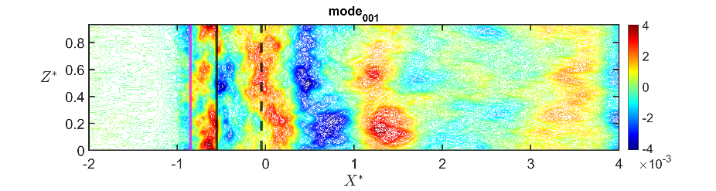





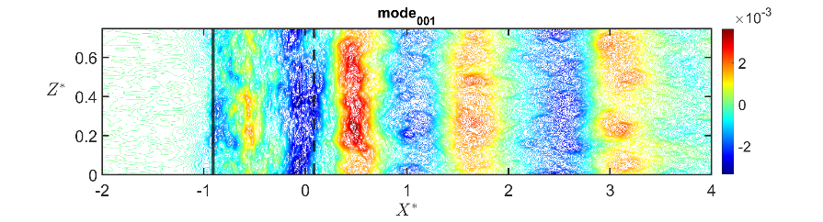
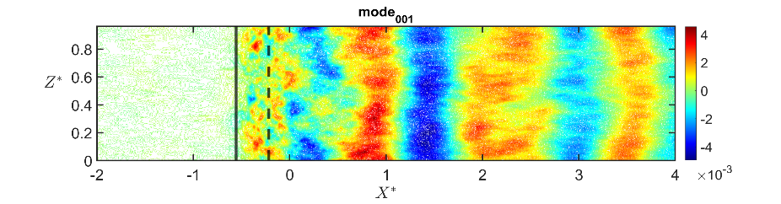



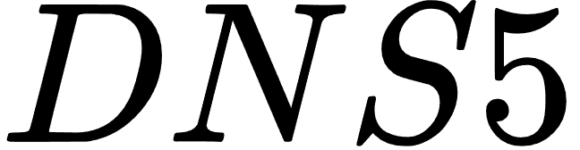

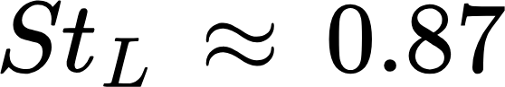
POD on wall pressure
here, we can see that in DNS3, the fluctuations of modes start way before that mean separation location.
The most energetic modes on the wall are medium frequencies.
These modes represent the effects of the advection of shear layer vortices on the wall after the reattachment.

Slide 7
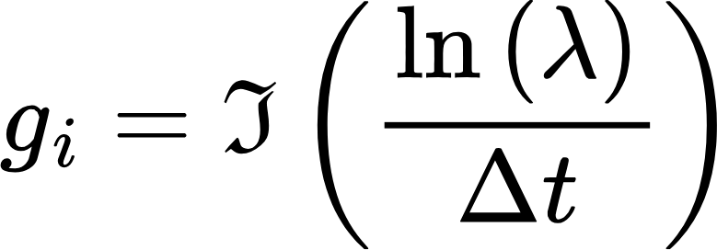
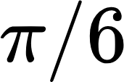
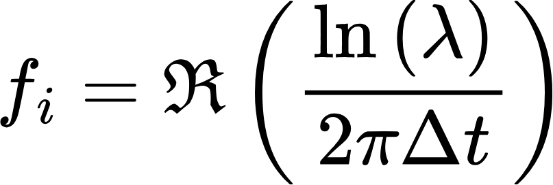
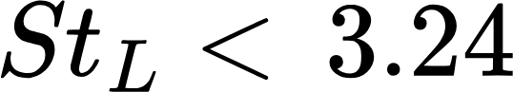
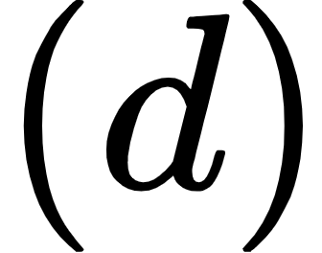
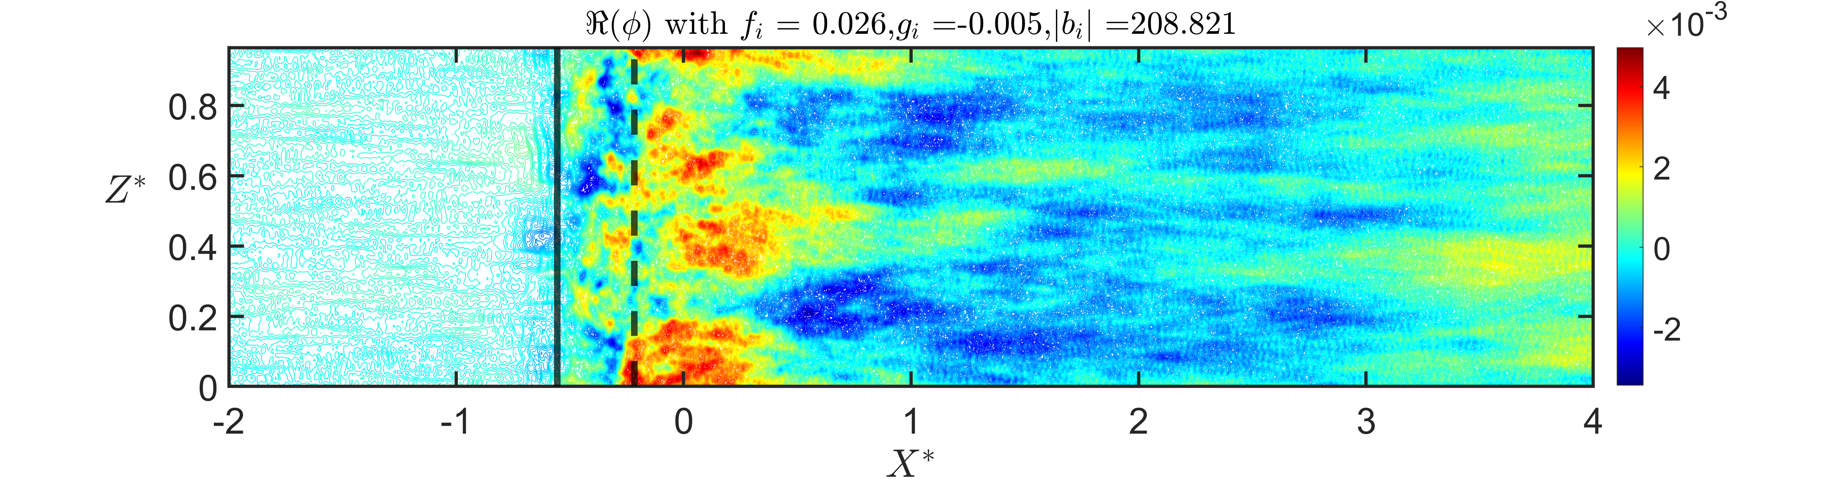
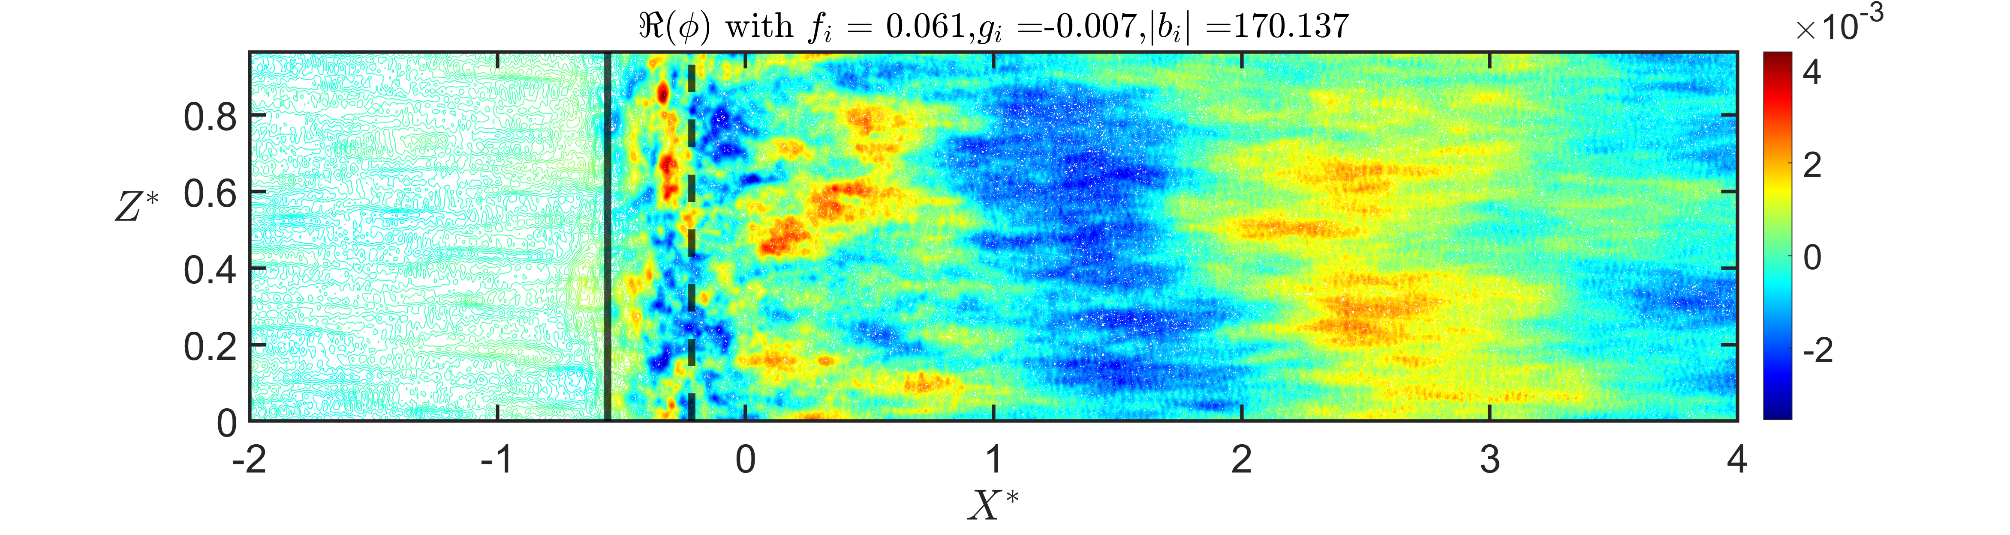
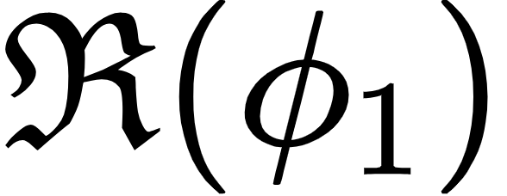
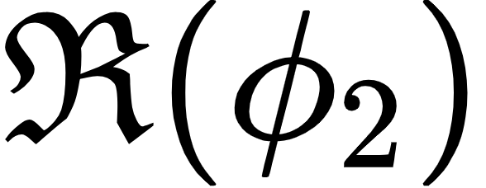
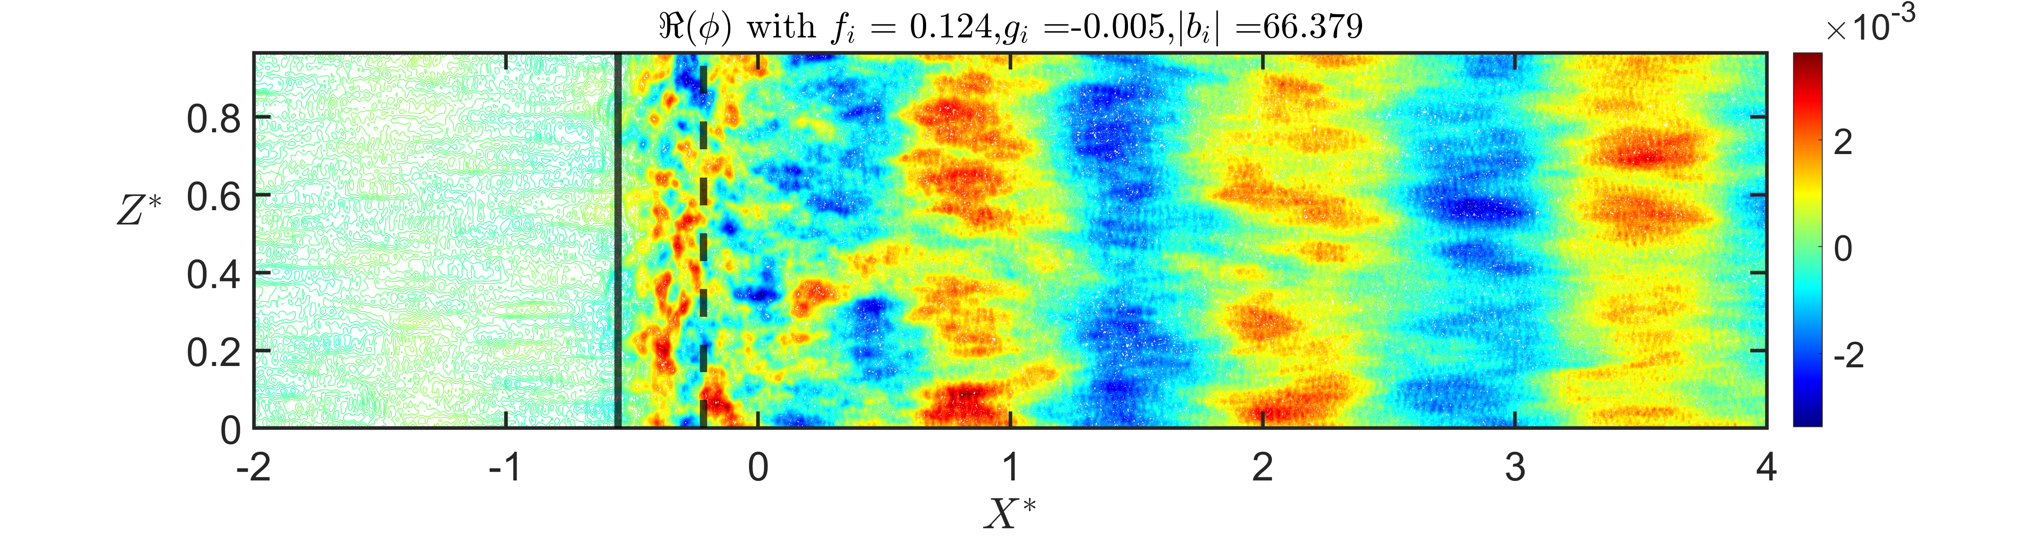
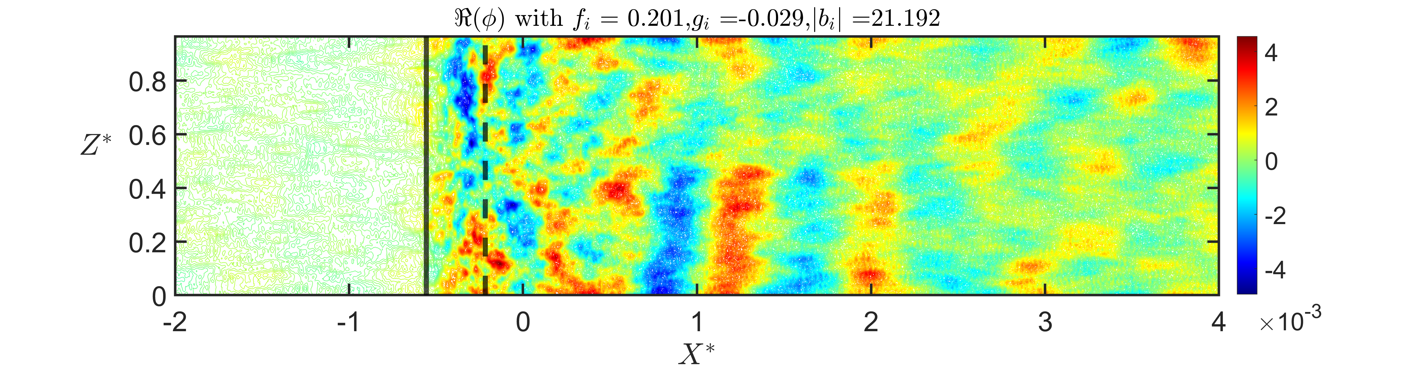
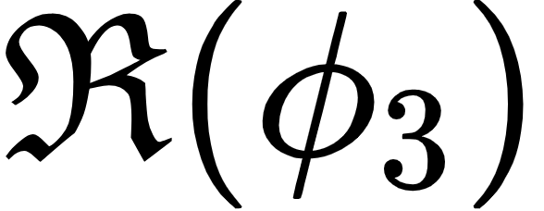
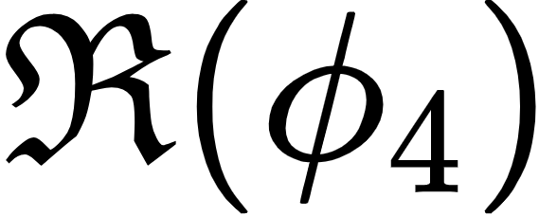
DMD on wall pressure (SVD based)
Ideal low-pass
filter with a phase angle of , higher frequencies was removed to highlight a specific
region of interest,
Görtler like structures.
like POD modes

Slide 8



